Slide 1
Human Resource Succession plan
Yuehong ge (Sissi)

Slide 2
Agenda
Introduction
Promotion Consideration
Qualifications
Performance Review
Work Experience
Employee Motivations
Desired Career Path
Mobility
Successional Model

Slide 3
Introduction

Slide 4
Introduction
This Presentation represents a succession plan that helps human resource department to determine the internal promotion candidates for specific open positions.
The succession plan model takes consideration of an employee’s work experience, motivation and job performance that relies on a company's evaluation criteria and 360 performance.

Slide 5
Promotion considerations

Slide 6
Promotion considerations
Promotion Considerations
Qualifications
Performance Review
Work Experiences
Motivation
Desired Career Path
Mobility

Slide 7
Qualifications-performance review
Different Department has different qualifications
Job Functions
Performance Evaluations
Position Levels
%
%
360 evaluations:
Customer
Peers
Manager
Self
Director
Manager
Team Lead
Individual
%

Slide 8
Qualifications-Work experience
Work Experience
Current Position
Industry Experience
in the Company
%
%
%

Slide 9
motivation
Employee desired career path
Career Path
Mobility
Motivation
Is an employee willing to re-locate for the promoted postion

Slide 10
Succession model

Slide 11
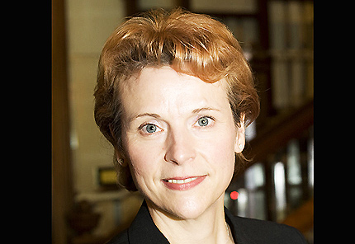
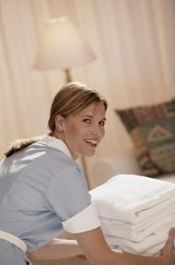
Succession Model
Open Position:
Housekeeping Supervisor
Open Position Recognition
Select Departments/Divisions
Select Career Path Level
Select Performance Review
Select work experience
Select mobility
Promotion
Name: Sara Allen
Age: 25 years Old
Current Area: Housekeeping
Current Division: Rooms
Current Job: Housekeeper ( line level)
Readiness Ratio: 3
Experience current position: 1 years
Experience in the area: 2 years
Experience within the company: 3 years
Mobility: yes
Sara is a person who has all the characteristics for the promotion the succession model will show her a candidate for the position alone with all the candidates with the characteristic that the employer requires.

Slide 12
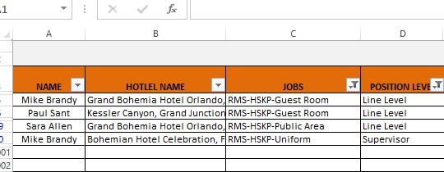
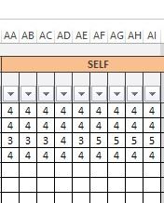
Succession Model
Employee Information: Basic Information
Please fill in the information of each employee:
Name, Hotel Name, Jobs, Position Level
Please fill in the nine qualifications scores evaluated by “self, supervisor”, “Subordinator” and “peers”

Slide 13
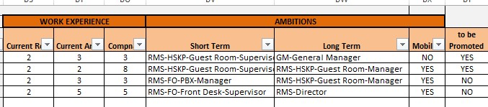
Succession Model
Employee Information : Desired Career Path & Work Experience
Please fill in the work experience and ambition session for each employee

Slide 14
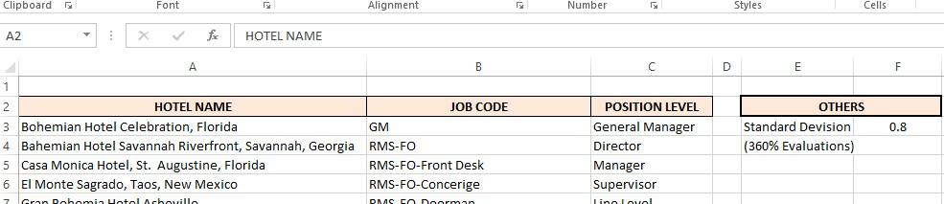
Succession Model
Input Information: Company Positions
In the Model, go to the “Input Information” Tab, please fill in:
Hotel Names: (filter the mobility)
All the names of the Kessler hotels
Job Code: (filter the desired career path)
job code for each job function. eg: RMS-FO-Front Desk
Position Level: (Qualification: performance review & work experience )
the levels of the positions eg: Manager, Line Level, Supervisor
Other (360 degree: performance review)
the maximum standard deviations of the scores from 360 degree evaluations

Slide 15
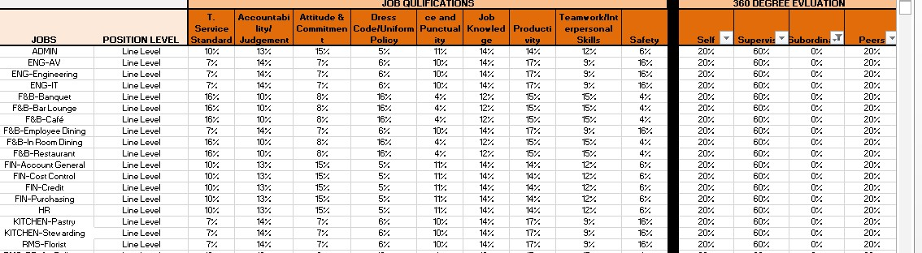
Succession Model
Weights for performance review
Different Departments have different qualification & 360 degree review weighs
In the Model, go to the “Job Weights” Tab, please fill in:
the weights of each job qualification
360 degree evaluation for each position

Slide 16
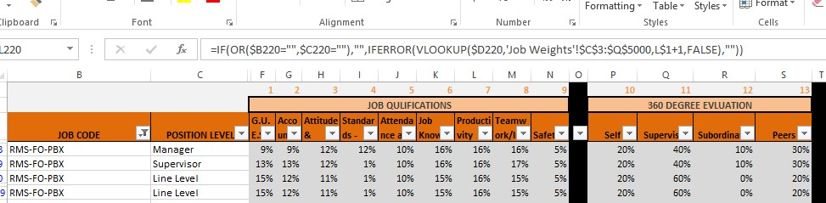
Succession Model
Job Performance Summary
The information from “Job Weights Summary” are the summary from “Job Weights” & “Input Information”. Users do not need to edit it.

Slide 17
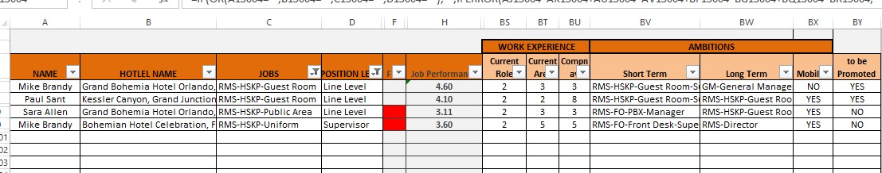
Succession Model
Results
*Red: the standard deviation is too high, the candidate should be re-evaluated.
Select the candidate according to the requirements of the open positions.

Slide 18
The end

